Slide 1
GİFS AND VİDEOS

Slide 2
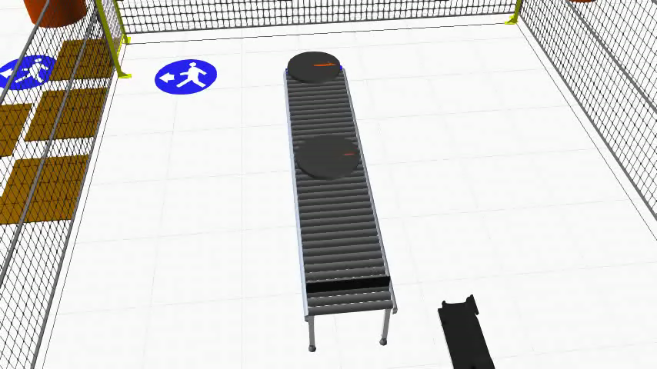
Going to Kuka KR 12 R1810 on the conveyor belt.

Slide 3
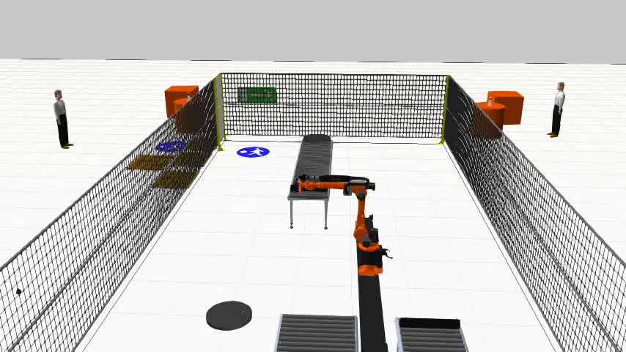
Throwing the Frisbee

Slide 4
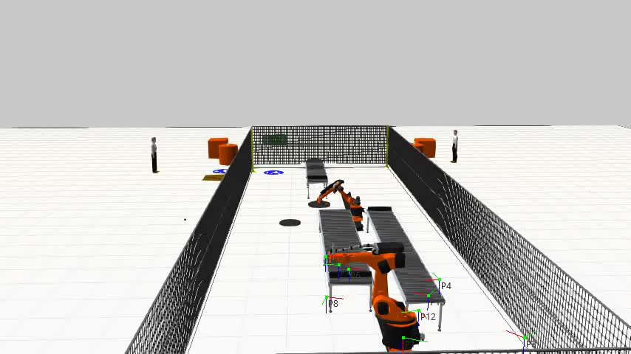
Assuming Frisbee on the conveyor and fall .

Slide 5
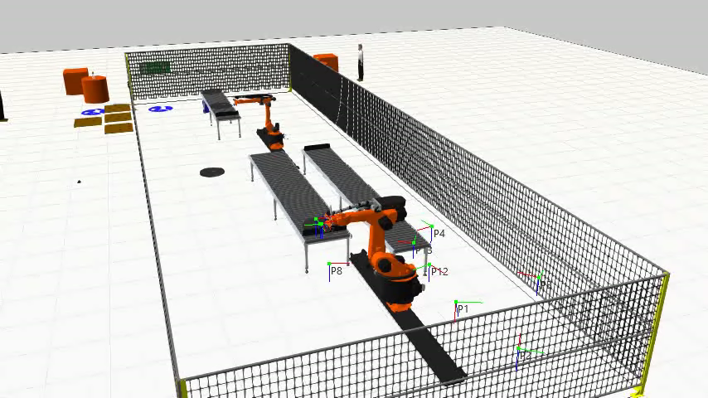
KR 30-3 Second Robot Throwing the Frisbee

Slide 6
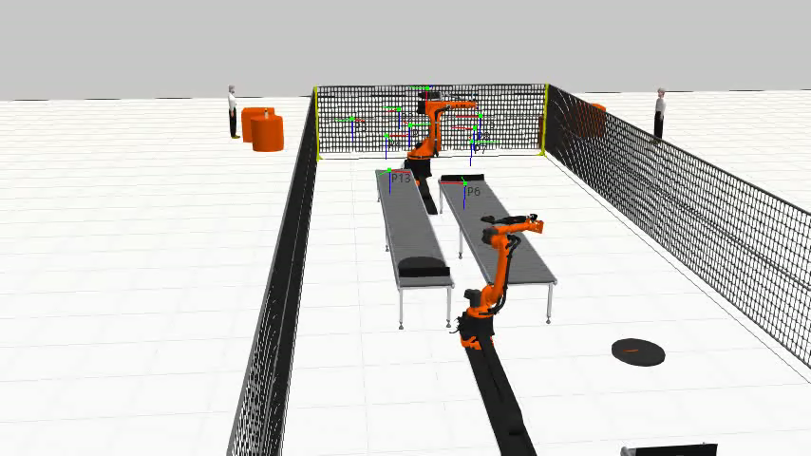
They are throwing one by one

